Slide 1
Introduction to Software Lecture 5: week 10
Credit : (03) / Week

Slide 2
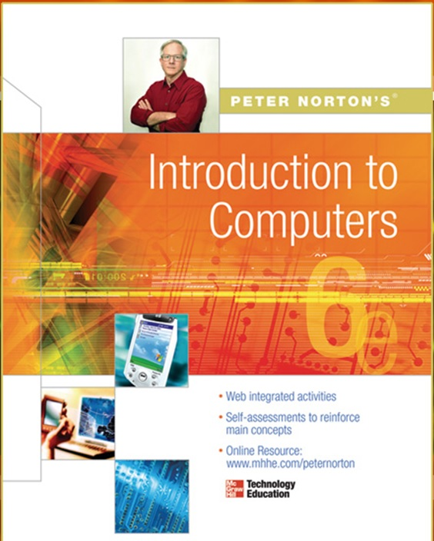
TEXT AND REF. BOOKS
Text Book:
Peter Norton (2011), Introduction to Computers, 7 /e, McGraw-Hill
Reference Book:
Gary B (2012), Discovering Computers, 1/e, South Western
Deborah (2013), Understanding Computers, 14/e, Cengage Learning
June P & Dan O (2014), New Perspective on Computer, 16/e

Slide 3

MOBILE ALERT
Kindly Switch Off your Mobile/Cell Phone
OR
Switch it to Silent Mode Please

Slide 4
Presented by: Simra Najm
Working with application software
Designation: Assistant Professor
Email: simranajm@neduet.edu.pk

Slide 5
Learning Outcome
What is Software
Software Types
System Software
Application Software (Word processor, Spreadsheets, Presentation etc)
Open Source Software
Proprietary Software
Utility Software
Malicious Software
Acquiring a Software

Slide 6
What is a Software ?
Computer software, or simply software is any set of machine-readable instructions that directs a computer's processor to perform specific operations.
Software tells the computer what to do and how to do.

Slide 7
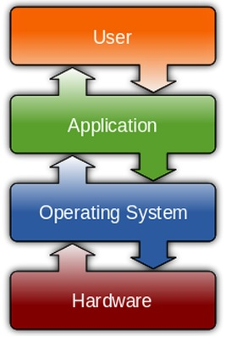
Types of Software
System Software
Application Software
Open Source Software
Proprietary Software
Malicious Software

Slide 8
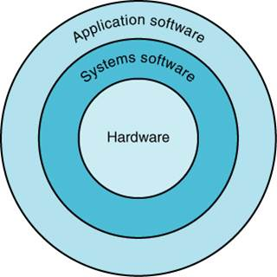
System Software
A program or set of programs that is especially designed to control different operations of computer system is called system software. It controls the working of different components of the computer.

Slide 9
System Software
System Software includes the Operating System (OS) and all the utilities that enable the computer to function.
System software is a term referring to any computer software which manages and controls the hardware so that application software can perform a task.
Example:
Operating Systems, Device Drivers, Interpreters

Slide 10
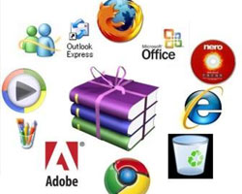
Application Software
It is a set of one or more programs designed to carry out operations for a specific application. Application software cannot run on itself but is dependent on system software to execute.
Example:
Payroll systems, Inventory Control,
Word Processor, Spreadsheet
and Database Management System etc.,

Slide 11
Open Source Software
Open source software (OSS) is computer software whose source code is available under a license that permits users to use, change, and improve the software, and to redistribute it in modified or unmodified form.
It is often developed in a public, collaborative manner.
Well-known OSS products are Linux, Netscape, Apache, etc.,

Slide 12
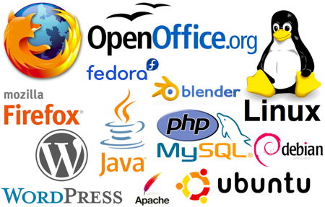
Open Source Software

Slide 13
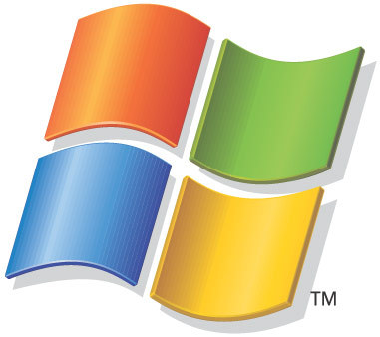
Proprietary Software
Proprietary software (non-free software)
Software with restrictions on using, copying and modifying as enforced by the proprietor. Restrictions on use, modification and copying is achieved by either legal or technical means and sometimes both.
Proponents (advocate) of proprietary software are Microsoft.
Example : MS Office/Windows, CAD, Norton AV etc.,

Slide 14
Types of System Software
OS Software
Device driver
Utilities

Slide 15
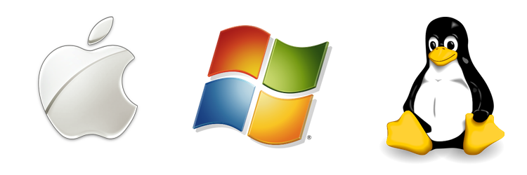
Operating System
An operating system (OS) is software that manages computer hardware and software resources and provides common services for computer programs.
Various characteristics of OS are described as

Slide 16
Characteristics of Operating systems
Multi-user
Allows two or more users to run programs at the same time. Some operating systems permit hundreds or even thousands of concurrent users
Multi-tasking
Allows a user to perform more than one computer task at a time

Slide 17
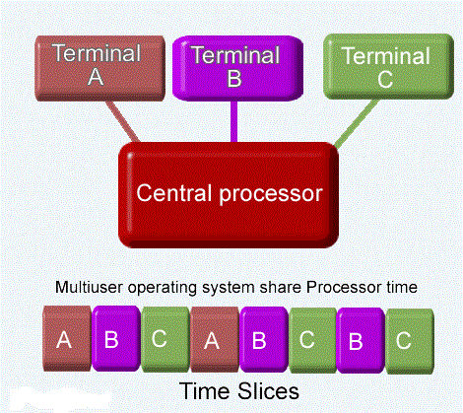
Multi-user / Multi tasking

Slide 18
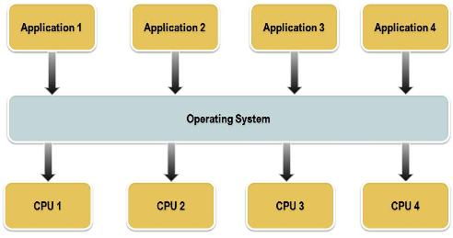
Characteristics of Operating systems
Multiprocessing
Use of two or more central processing units (CPUs) within a single computer system for running a program or application

Slide 19
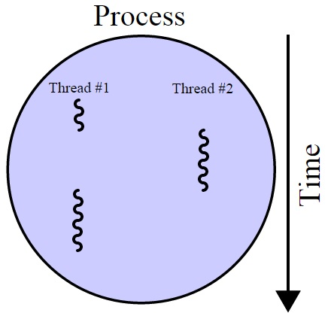
Characteristics of Operating systems
Multithreading
The ability of an operating
system to execute different
parts of a program, called
threads, simultaneously

Slide 20
Types of Operating Systems
Single user/Single tasking OS
One user works on the system
Performs one task at a time
MS-DOS and Palm OS
Take up little space on disk
Run on inexpensive computers

Slide 21
Types of Operating Systems
Single user/Multitasking OS
User performs many tasks at once
Most common form of OS
Windows XP/7/8 and OS X
Require expensive computers
Tend to be complex
Multi-tasking operating systems are complex
However both XP and OS X make the multitasking process painless
Notes:
Teaching tip
It is true that multi-tasking operating systems are complex. However both XP and OS X make the multitasking process painless for the user.

Slide 22
Types of Operating Systems
Multi user/Multitasking OS
Found on supercomputers, mainframes and minicomputers
Many users connect to one computer
Each user has a unique session
UNIX, Linux, and VMS
Maintenance can be easy
Requires a powerful computer
Notes:
Teaching tip
Multi-user Multitasking OS's are found on supercomputers, mainframes and minicomputers. Through Linux, a PC can also support user sessions and terminal connections.

Slide 23
Characteristics of Operating systems
Real time
A system is said to be Real Time if it is required to complete it’s work & deliver it’s services on time or instantly
Example – Flight Control System
All tasks in that system must execute on time.

Slide 24
Types of Operating Systems
Real-time operating system
A system is said to be Real Time if it is required to complete
it’s work & deliver it’s services on time or instantly
Example – Flight Control System, Medical devices
All tasks in that system must execute on time
Very fast small OS
Built into a device
Respond quickly to user input

Slide 25
Characteristics of Operating systems
Hard Real Time System
Failure to meet deadlines is fatal
example : Flight Control System
Soft Real Time System
Late completion of jobs is undesirable but not fatal
System performance degrades as more & more jobs miss deadlines
Online Databases

Slide 26
Device Driver
A device driver (commonly referred to as simply a driver) is a computer program that operates or controls a particular type of device that is attached to a computer.
Examples Mouse driver, keyboard driver, video card driver, sound card driver

Slide 27
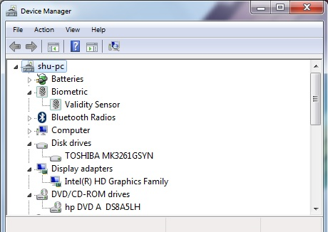
Device Driver

Slide 28
Enhancing an OS
Utilities
Provide services not included with OS
Goes beyond the four functions (i.e. ? ? ? ? )
Firewall, anti-virus and compression
Prices vary
Notes:
Discussion point
With Windows XP and SP2, Microsoft has included a firewall and pop-up blocker both typically considered utility software. In the near future, the core services provided by an OS may include security features.

Slide 29
Utility Software
A utility software is a small program that provides an addition to the capabilities provided by the operating system
In some usages, a utility is a special and nonessential part of the operating system
Examples Disk Management, Disk Format etc

Slide 30
A utility or software utility is computer system software intended to analyze, configure, monitor, or help maintain a computer. Typically a utility is smaller than a standard program in size and may be included with an operating system or installedseparately.

Slide 31
Examples:
Antivirus
Backup software
Clipboard
Compression utility
Cryptography software
Debuggers
DirectX
Disk checkers (e.g., Defrag, Disk Cleanup, and ScanDisk).
Disk partition editors
Dr. Watson
Encryption tools
File manager
Hex editor
Memory tester
Network monitors
Package manager
Registry cleaners

Slide 32
Enhancing an OS
Backup software
Archives files onto removable media
Ensures data integrity
Most OS include a backup package
Many third party packages exist

Slide 33
PC Operating Systems
DOS
Disk Operating System
Single user single-tasking OS
Command line interface
16-bit OS
Powerful
Fast
Supports legacy applications
Notes:
Teaching tip
Students often fail to see the value in older OS or applications. As an example, a metal fabrication plant in Pittsburgh PA is still using a program written in the early 70’s that calculates metal temperatures.

Slide 34
PC Operating Systems
Windows 9x
95, 98, and Millennium Edition (Me)
32-bit OS
Supported 16-bit programs well
Very pretty not stable OS
Still found in large corporations
95 introduced the Start button
98 introduced active desktop
Me improved multimedia software

Slide 35
PC Operating Systems
Windows XP
Microsoft’s newest desktop product
Different look from 2000
Many different versions
Digital multimedia support was enhanced
Communications was enhanced
Mobile computing became a priority
Notes:
Teaching tip
At press time, the 64 bit version of XP was still in the late beta stage. More information can be found at www.microsoft.com/presspass/press/2003/sep03/09-23athlon64betapr.asp.

Slide 36
Embedded Operating Systems (EOS)
fix , set
firm
Initially EOD designed for specific purpose or task
With limited resources
Later on definition changes:
Now EOS considered as : (Something) in a specified place or position with limited number of resources.

Slide 37
Embedded Operating Systems (EOS)
These operating systems are designed to be compact, efficient at resource usage, and reliable
Very limited in resources such as RAM and ROM
Stable and fast
Must be reliable and able to run with constraints on memory, size and processing power
Devices have EOS built in
Cell phones, PDAs, Digital Cam, Medical equipment

Slide 38
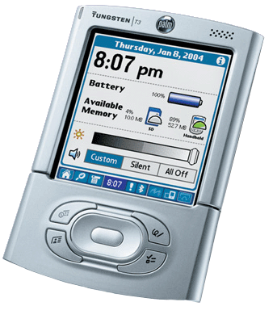
Embedded Operating Systems
Palm OS
Mobile operating system initially developed by Palm, for personal digital assistants (PDAs) in 1996
Standard on Palm PDA
First PDA OS for consumers
Can be found on cell phones

Slide 39
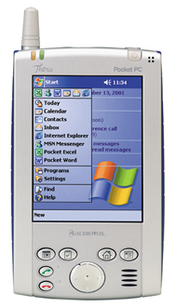
Embedded Operating Systems
Pocket PC
Developed to compete with Palm
Uses the Microsoft's Windows Mobile
Operating system
Not customizable
Interacts securely with business networks
Can control PCs through PC

Slide 40
Embedded Operating Systems
Android
Mobile operating system (OS) based on the Linux kernel and developed by Google
Primarily for touch screen mobile devices
Found in smart cell phones
Games, Instant Messaging, Internet
Full color display
Most popular mobile OS. As of 2013,

Slide 41
Some common functions of SYSTEM SOFTWARE(OS)
Providing Graphical user interface (GUI)
Most common interface
Windows, OS X,
Uses a mouse to control objects
Uses a desktop metaphor
Shortcuts open programs or documents
Open documents have additional objects
Task switching
Dialog boxes allow directed input
The first commercial GUI was the Xerox Star.
The first commercial GUI was the Xerox Star (1981)

Slide 42
Managing Hardware
Programs need to access hardware
Interrupts
A signal informing a program/CPU that an event has occurred
CPU is stopped
Hardware device is accessed
IRQ’s (Interrupts Requests)
IRQs are hardware lines over which devices can send interrupt signals to the microprocessor
Device drivers control the hardware
Notes:
Discussion point
The mouse uses an interrupt. Many users will move the mouse while waiting for the CPU to finish a task. What does moving the mouse do to the current process?
Teaching tip
Discuss what can happen when the wrong driver is installed on a computer.

Slide 43
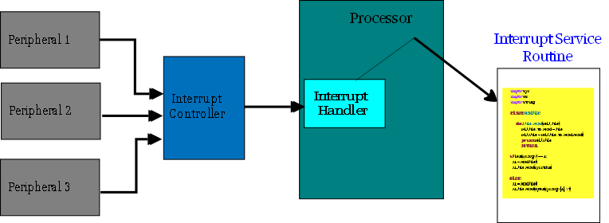
Interrupts

Slide 44
Organizing Files and Folders
Organized storage
Long file names
Microsoft's way of implementing filenames longer than the 8.3 filename
255 Character long
Folders can be created and nested
All storage devices work consistently

Slide 45
Types of Application Software
Word Processing Software
This software enables users to create and edit documents. Word processing is a tool that helps user in creating, editing, and printing documents.
Examples: Microsoft Word

Slide 46
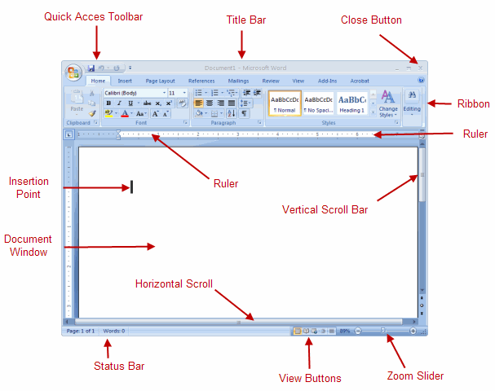

Slide 47
Types of application software
Spreadsheet Software: The spreadsheet packages are designed to use numbers and formulas to do calculations with ease.
They simulate paper worksheets by displaying multiple cells that make up a grid
The most commonly used spreadsheet programs are
Excel, Lotus 1-2-3 and Apple Numbers etc
Notes:
Grid: A pattern of regularly spaced horizontal and vertical lines

Slide 48
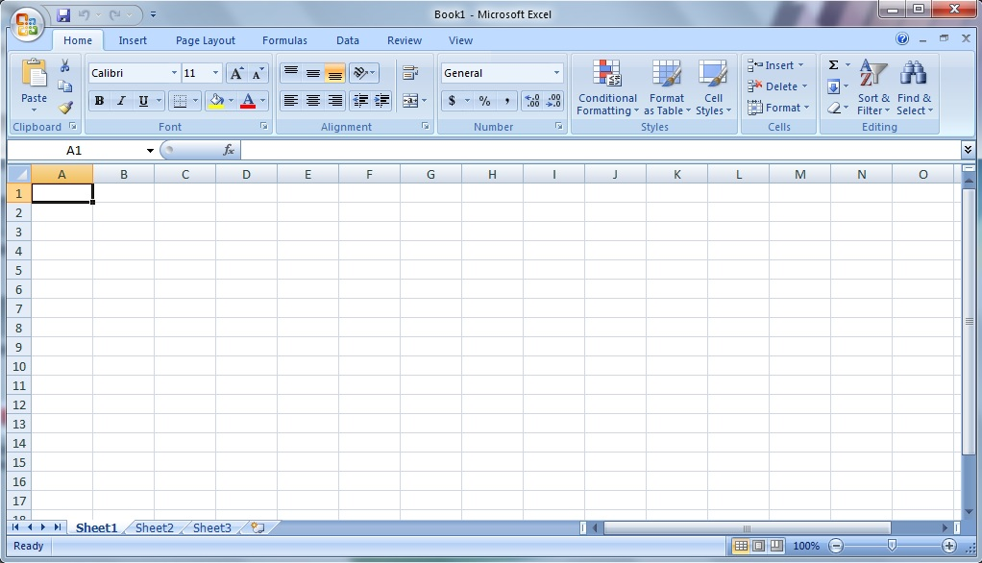

Slide 49
Types of application software
Presentation Software: The software that is used to display information in the form of a slide show is known as presentation software i.e. Microsoft PowerPoint
Other uses include:
Slide Shows
Repeating Computer Presentations on a computer monitor
Using Sound and animation in slide shows

Slide 50
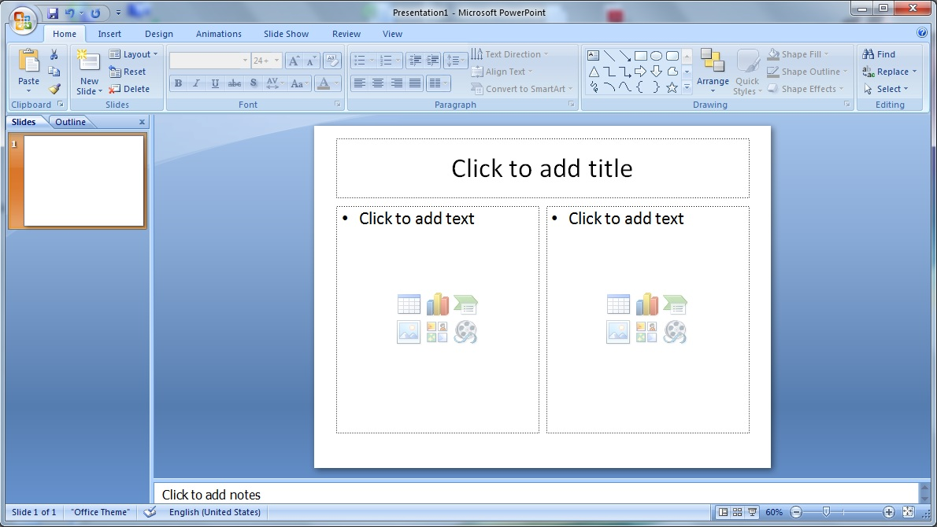

Slide 51
Types of application software
Database Software
Database is a structured collection of data. Database software allows users to store and retrieve data from databases. Examples are MS Access etc.

Slide 52
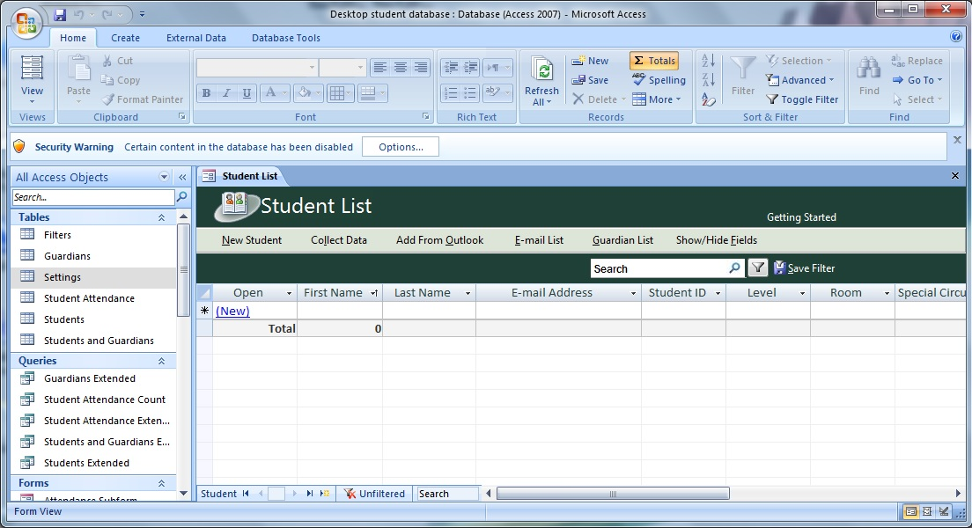

Slide 53
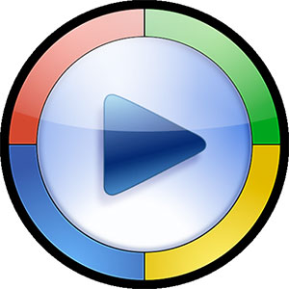

Types of application software
Multimedia Software
Allow users to create and play audio and video files. They are capable of playing media files
Examples of this type of software include Real Player and Media Player etc

Slide 54
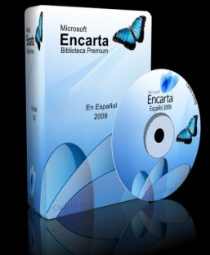


Types of application software
Educational Software: It has the capabilities of running tests and tracking progress. It is often used in teaching and self-learning
Examples
Encarta
Britannica
Google Earth etc

Slide 55
Types of application software
Simulation Software
Used to simulate physical or abstract systems, simulation software finds applications in both, research and entertainment.
Flight simulators and scientific simulators are examples of simulation software.

Slide 56
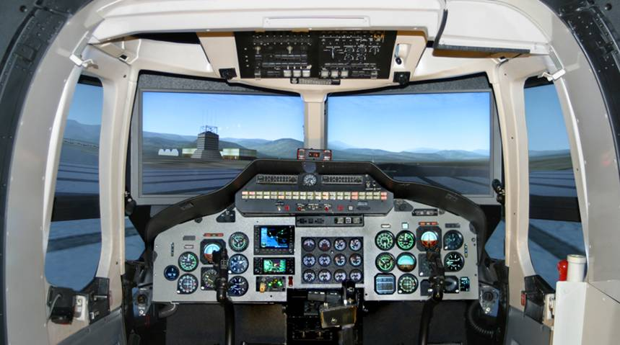
Simulation Software : Flight Simulator

Slide 57
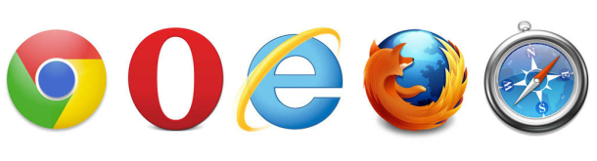
Types of application software
Content Access Software: It is used to access content without editing. Common examples of content access software are web browsers and media players.

Slide 58
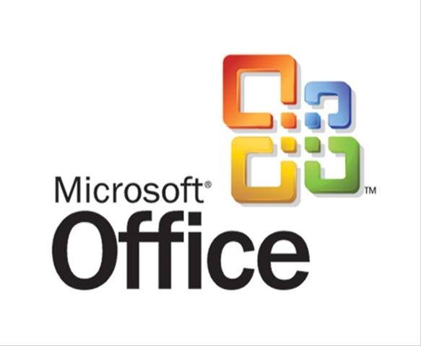

Types of application software
Application Suites: It consists of a group of applications combined to perform related functions.
OpenOffice and Microsoft Office are the best examples

Slide 59

Malicious Software
Malware or malicious software, is any software used to disrupt computer operation, gather sensitive information, or gain access to private computer systems
Malware includes computer viruses, worms, trojan horses, spyware, adware and other malicious programs.

Slide 60
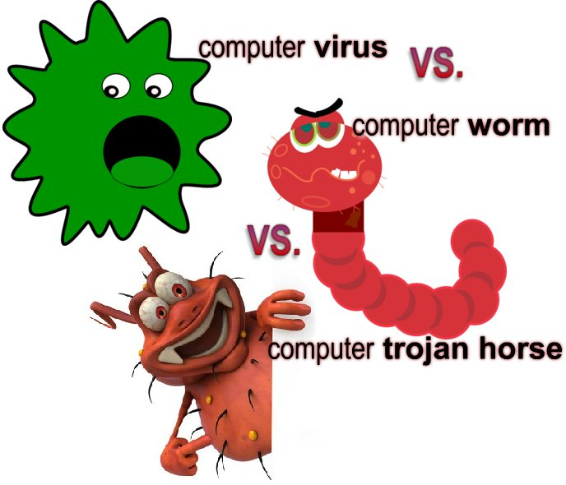
Malicious Software
Virus
Virus is a program written to enter to your computer and damage/alter your files/data. A virus might corrupt or delete data on your computer
Worms
Malicious programs that make copies of themselves again and again on the local drive, network shares, etc

Slide 61

Malicious Software
Trojan Horse
It is a destructive program that looks as a genuine application. Trojans also open a backdoor entry to your computer which gives malicious users/programs access to your system
Adware
A software application in which advertising banners are displayed. Auto download to your system with some program

Slide 62

Malicious Software
Spyware
They installed with or without your permission on your PC to collect information about users, their computer or browsing habits
Tracks each and everything that you do without your knowledge and send it to remote user
Computer Geniuses normally write malicious codes for some reason

Slide 63

END OF LECTURE 5
Any Questions !!!
Notes:
Resources:
http://www.buzzle.com/articles/different-types-of-application-software.html
http://en.wikipedia.org/wiki/Malware
http://en.wikipedia.org/wiki/Application_software

